Slide 1



Quality of Care for Chronic Disease Management
Vaibhav Gaikwad // 2018HT12597
BIRLA INSTITUTE OF TECHNOLOGY & SCIENCE
PILANI (RAJASTHAN)
April 2020
Notes:
Intro:
My name is Vaibhav Gaikwad, am a Tech Arch at Philips VH. almost 13 years now
I am going to present of QoC for CDM applications which is the forte of PVH
The work started in 2nd week of Feb and was finalized on 24th Apr (around 2 months and 1 week more or less)

Slide 2
Nobody ever figures out what life is all about, and it doesn't matter. Explore the world. Nearly everything is really interesting if you go into it deeply enough.
- Richard P. Feynman
Notes:
1. Interesting quote which I felt is relevant in general and also in terms of this study

Slide 3
Introduction
In the healthcare domain, the applications are built around the idea of providing care.
Philips VitalHealth has various chronic disease management solutions build for diseases (e.g. Diabetes, COPD, Asthma, etc.).
Philips culture supports innovation to add more value to the products for staying ahead of the competition.
One of the widely talked Unique Selling Point (USP) is about Quality of Care (QoC) in the solutions.
The dissertation work focuses on the research of building a model for the assessment of QoC.
Notes:
The work is more on research and design rather than the implementation for the QoC
Idea: We can dig out QoC from applications using Patient’s medical data , this idea was not generally accepted due to the fact that the HQ is in NL and people believe that QoC is already put into place. Of course I had to debate with the key members about it’s business value in other parts of the world and also in developed nations

Slide 4
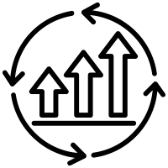
Motivations
Analysis of Quality of Care (QoC) is about gaining information about the effectiveness of care management for the patients.
QoC is stated good when the health of the population is stable or improving.
QoC is also a measure of the effectiveness of a treatment protocol.
QoC in a business case means proving the ROI (return on investments) to customers.
QoC measurement is a must for accountable care as per CDC’s Meaningful Use policy.
Notes:
1. the point related to ROI really helped me to push this idea and get the support from the key members for this work

Slide 5
Observations & Objectives
Observations
Current solutions have little or no way to assess the QoC.
Knowledge related to QoC is observed in the people but is not yet implemented.
Ad-hoc methods are adopted for QoC report generation on a need basis.
Data needed for assessing QoC is present in the existing system.
Learning
QoC depends on risk-based groups identification, more care is need for high-risk patients (clustering)
Objectives
Define a way to find QoC attributes for an application
Identification of low, moderate and high risk patients
Propose a model to assess the QoC using those attributes
Notes:
Some initial observations are present in the first paragraph
This was not a generic solution idea, so we shortlisted Diabetes application as that had majority implementations
Why clustering? – The unsupervised learning should also give same results as we get in real world, related to groups

Slide 6
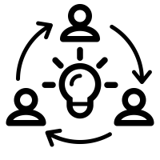



Work on Quality of Care
Division of work
Ideation and design
Data collection and analysis
Searching for risk groups
Design for Quality of Care
Notes:
2 months + 1 week
1 week was spent on point 1,
Roughly 1 and half month on point 2 and 3 - Most time was spent on point 2 and 3 as some of the initial assumptions were not accurate and needed some rethinking. That we will see as we continue.
Again a 1 week or slightly more on the last point
Last 1 week for mapping data attributes from this work to actual application in Philips called Coordinate and creating internal report for company mentor and management
Report generation was done in parallel

Slide 7
Ideation
Brainstorming sessions helped to understand the ways to find QoC.
Summarizing the patient feedback at the overall level gives information about the quality of care.
The adoption of such a method does not seem very accurate and feedback is always optional.
Trend analysis of each patient’s health can also provide details on the Quality of Care.
This method is time-consuming and does not generate insights on the population level.
Compare data from previously used applications which have proved better Quality of Care.
It is difficult to achieve due to the dependency on finding a trustable system.
Research requirement was gathered, and a proposal was made with the objectives.
Research a way to find attributes for an application useful for QoC.
Propose a design to assess the QoC for an application.

Slide 8
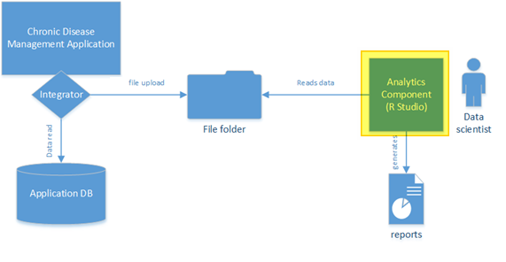
Ideation System block diagram
The focus is on the design of the Analytics Component.
Rest of the integrations will be considered during the actual implementation.

Slide 9
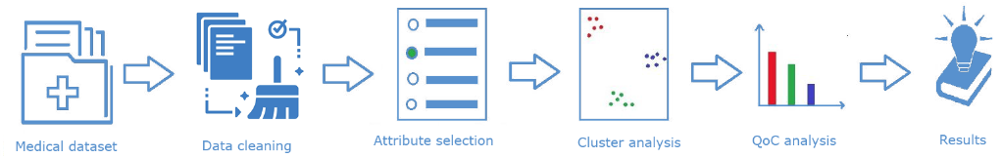
Ideation Analytics Component
Chronic Disease Management (CDM) application holds the medical data, and can be exported.
Data cleaning removes insignificant data from the exported dataset.
Attribute selection helps to find the valuable data attributes helpful for clustering.
Cluster analysis helps to understand the risk-based group formations.
QoC analysis will help in understanding if the care management is effective or not.
Results will be the reports that are generated for the care organisation.
Notes:
Data export was itself going to be small size project
Last point was related to making some application reports
First and last point were kept out of the scope

Slide 10
Data Analysis Collection
Privacy contracts made it difficult to use applications with live data.
Dataset from Kaggle.com was used referred to as PIMA dataset, which had 786 records for diabetic and non-diabetic female patients.
Following eight data attributes were present as listed in the table.
Data attribute | Description
Pregnancies | Number of times pregnant
Glucose | Plasma glucose concentration (2 hours) oral glucose tolerance
BloodPressure | Diastolic blood pressure (mm Hg)
SkinThickness | Triceps skinfold thickness (mm)
Insulin | 2-hour serum insulin (mu U/ml)
DiabetesPedigreeFunction | Score for likelihood of Diabetes based on family history
BMI | Body mass index (weight in kg / (height in m) ^2)
Age | Age for a person in years
Outcome | Class variable (0 or 1) whether or not a patient has Diabetes

Slide 11
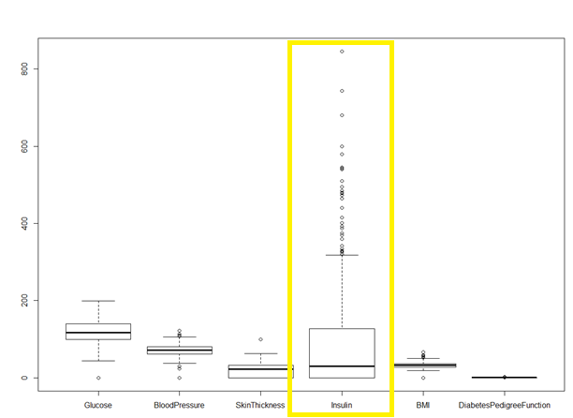
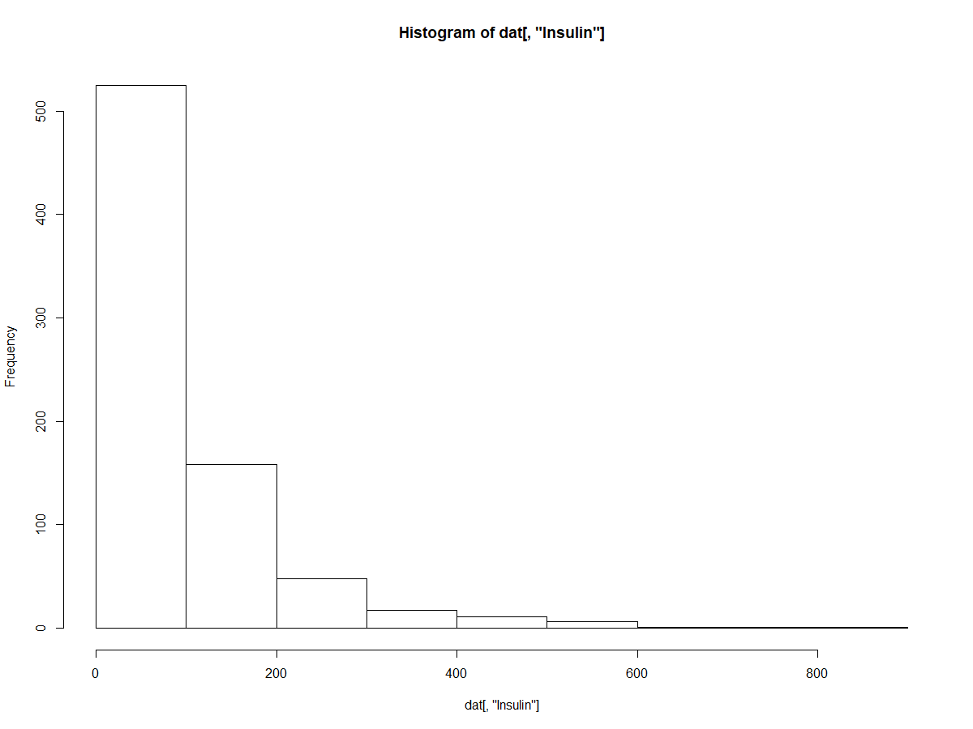
Data Analysis Cleaning
As study was not gender specific “Pregnancies” data was neglected.
Removal of records with 0 value for Glucose, Blood Sugar, BMI, (i.e. all 3 attributes were 0).
Number of were reduced to 249 after the data cleaning process.

Slide 12
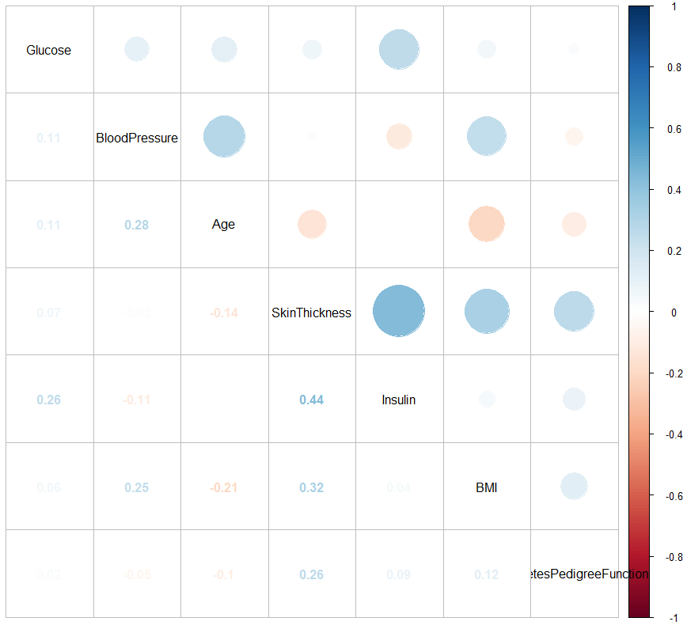
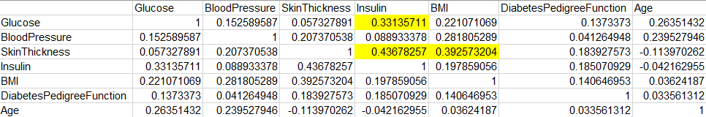
Data Analysis Correlations among attributes
Correlations in filtered data listed below.
Glucose and Insulin (obvious)
SkinThickness and Insulin
SkinThickness and BMI
Weak correlations were seen, so attributes are not correlated.
Notes:
After understanding the co-relations between the attributes, the next part was to understand clustering over this dataset
Unsupervised Clustering was chosen because the idea was to generate risk based groups from the data without adding real world knowledge to it.
Results from clustering over raw data were generated to get some hints
Initial assumption was “good separated clusters” should show risk based groups

Slide 13
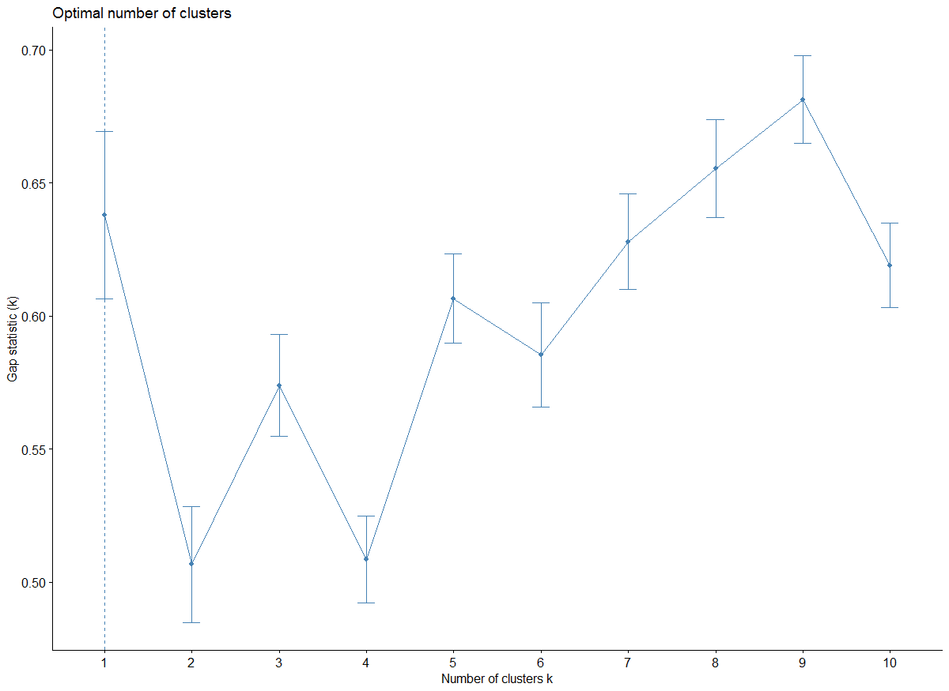
Search Risk Groups Standard K-means (gap-stat)
K-means execute with gap-stat indicated the data is not separable, as optimal K value was 1.
K-means with seven data attributes for K = 3 was not useful. Results in table below.
Conclusion: Data was not easily separable into groups based on risk using default K-means.
Cluster No. | Glucose | BloodPressure | Insulin | BMI | Age
Cluster 1 | 88 - 198 | 30 - 110 | 96 - 328 | 23.4 - 67.1 | 21 - 58
Cluster 2 | 124 - 197 | 50 - 90 | 360 - 846 | 28 - 46.2 | 21 - 60
Cluster 3 | 78 - 199 | 50 - 114 | 0 - 91 | 22.9 - 59.4 | 21 - 70
Notes:
Gap Statistic Method
The gap statistic has been published by R. Tibshirani, G. Walther, and T. Hastie (Standford University, 2001).
The approach can be applied to any clustering method (i.e. K-means clustering, hierarchical clustering).
The gap statistic compares the total intra-cluster variation for different values of k with their expected values under null reference distribution of the data (i.e. a distribution with no obvious clustering).
The reference dataset is generated using Monte Carlo simulations of the sampling process.
That is, for each variable (xixi) in the data set we compute its range [min(xi),max(xj)][min(xi),max(xj)] and generate values for the n points uniformly from the interval min to max.
The estimate of the optimal clusters (^kk^) will be the value that maximizes Gap(k).

Slide 14
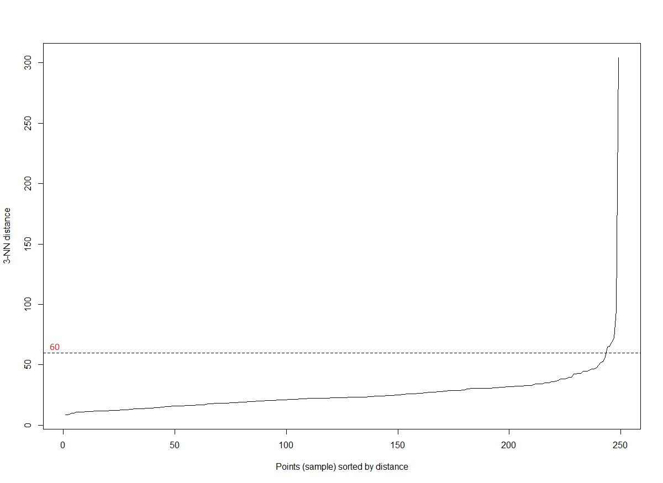
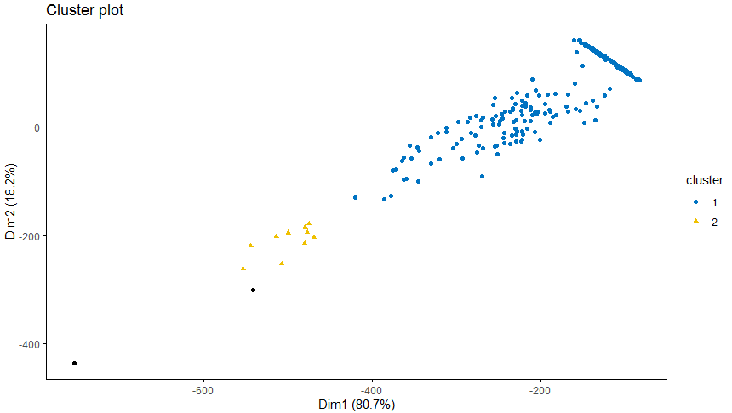
Search Risk Groups Standard DBSCAN (kNN)
DBSCAN was tested with kNN for K = 3 and min eps distance was observed to be between 60 to 80
DBSCAN with eps = 60 and MinPts = 3, generated 2 clusters but did not generate any useful results in regards to the risk groups.
Conclusion: DBSCAN is not a correct choice to proceed, as data is not easily separable.
Cluster No. | Glucose | BloodPressure | Insulin | BMI | Age
Cluster 1 | 78 - 199 | 30 - 114 | 0 - 392 | 22.9 - 67.1 | 21 - 70
Cluster 2 | 142 - 197 | 52 - 90 | 465 - 579 | 30.1 - 43.3 | 21 - 60
Notes:
Density-based spatial clustering of applications with noise
eps is the maximum distance between two points in same cluster
optimal eps was calc’ed using “kNNdistplot” method for K = 3
make use of the average distances of every point to its k nearest neighbors. These k distances are then plotted in ascending order. The point where you see an elbow like bend corresponds to the optimal *eps* value
So now we move to Elbow method

Slide 15
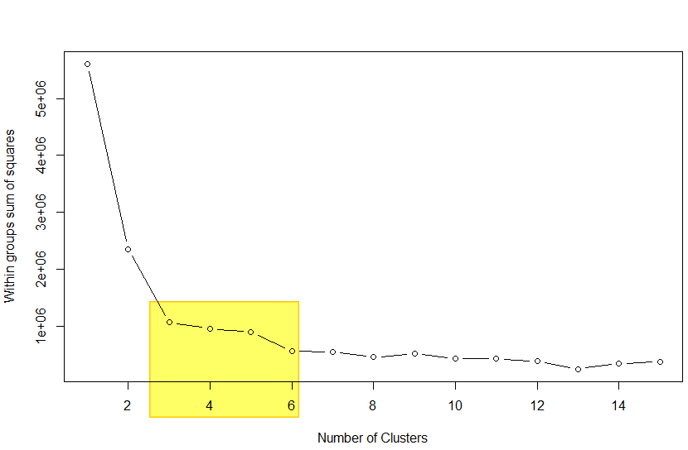
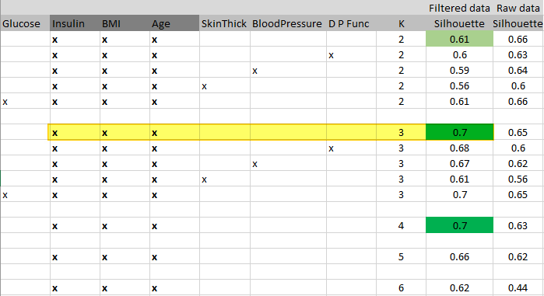
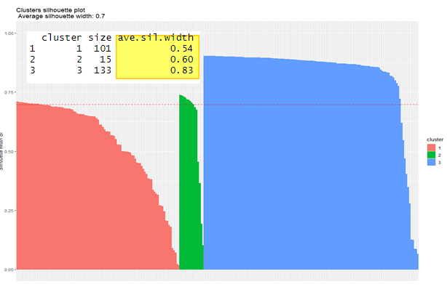
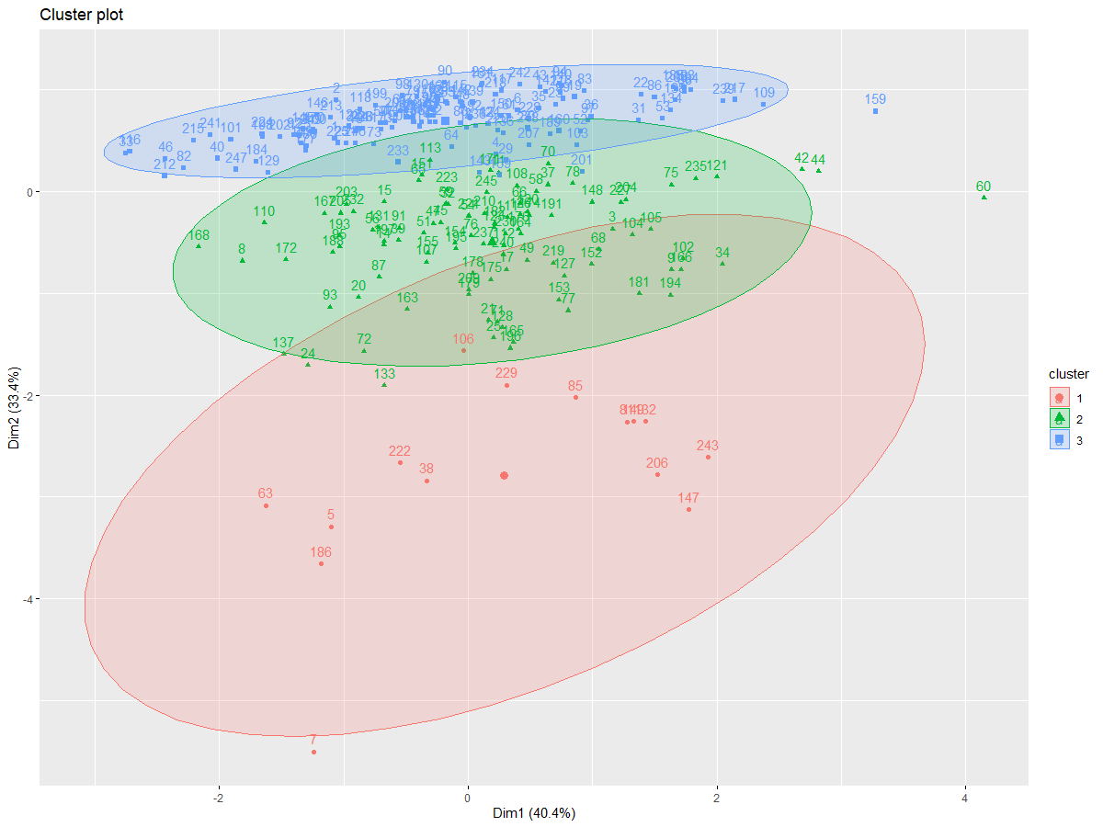
Search Risk Groups K-means clustering & Silhouette analysis
Elbow analysis confirmed K = 3 lies in optimal section.
Silhouette analysis iterations were carried for K [2-6] to find the attributes which resulted in good clustering in K-means.
Attributes [Insulin, BMI, Age] were found promising at value 0.7 for Average Silhouette Width (ASW).
Notes:
K is fixed as 3 mostly to find 3 risk based groups

Slide 16
Search Risk Groups Range formation
The Insulin based range formation was visible.
Cluster 3 has a low range [0-9].
Cluster 1 has the moderate range [96 - 328].
Cluster 2 has the high range [360 - 846].
The result was not promising so attribute selection with Random Forest method was performed and clustering was redone.
Cluster No. | Glucose | BloodPressure | Insulin | BMI | Age
Cluster 1 | 88 - 198 | 30 - 110 | 96 - 328 | 23.4 - 67.1 | 21 - 58
Cluster 2 | 124 - 197 | 50 - 90 | 360 - 846 | 28 - 46.2 | 21 - 60
Cluster 3 | 78 - 199 | 50 - 114 | 0 - 91 | 22.9 - 59.4 | 21 - 70
Notes:
So I had to start again with attribute selection, so I started reading on the best approaches for it, when I came across Random Forest (the papers are mentioned in the references too)

Slide 17
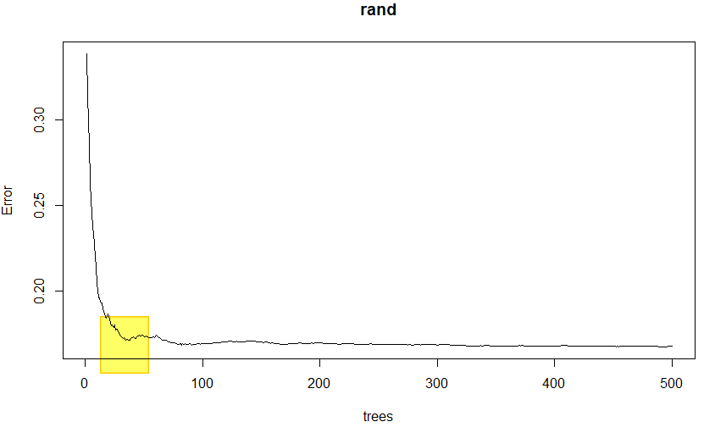
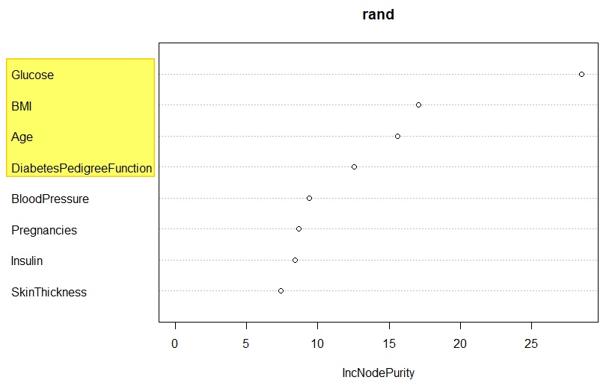
Search Risk Groups Random Forest and Attribute Selection
Random Forest indicated the optimal attribute combination was [Glucose, BMI, Age]. If range formation is not observed then DPF attribute can be added.
Positive results were seen using the [Glucose, BMI, Age] after clustering.
ASW = 0.37 was observed and was comparatively low but still in the valid range (positive).
Conclusion: Unsupervised learning can detect risk based groups
Cluster No. | Glucose | BloodPressure | Insulin | BMI | Age
Cluster 1 | 78 - 125 | 30 - 100 | 0 - 258 | 22.9 - 55 | 21 – 62
Cluster 2 | 160 - 199 | 50 - 110 | 0 - 846 | 23.3 - 59.4 | 21 – 66
Cluster 3 | 123 - 159 | 40 - 114 | 0 - 600 | 23.8 - 67.1 | 21 - 70
Notes:
First plot describes the optimal no. of trees needed for Random Forest with min. error > 70/30 train test data was used, trees = 80 to 100, where the accuracy went from 72.92 to 73.79
Second plot is from varImpPlot - variable importance as measured by a Random Forest (Mean Decrease Accuracy (%IncMSE) and Mean Decrease Gini (IncNodePurity) )
Now that we have made sure about the group formation and the QoC attributes and how to search the best ones, we move to the design of QoC assessment using this clusters
We have identified high-risk population and now we have to manage them over time and understand the trend to comment on the QoC

Slide 18
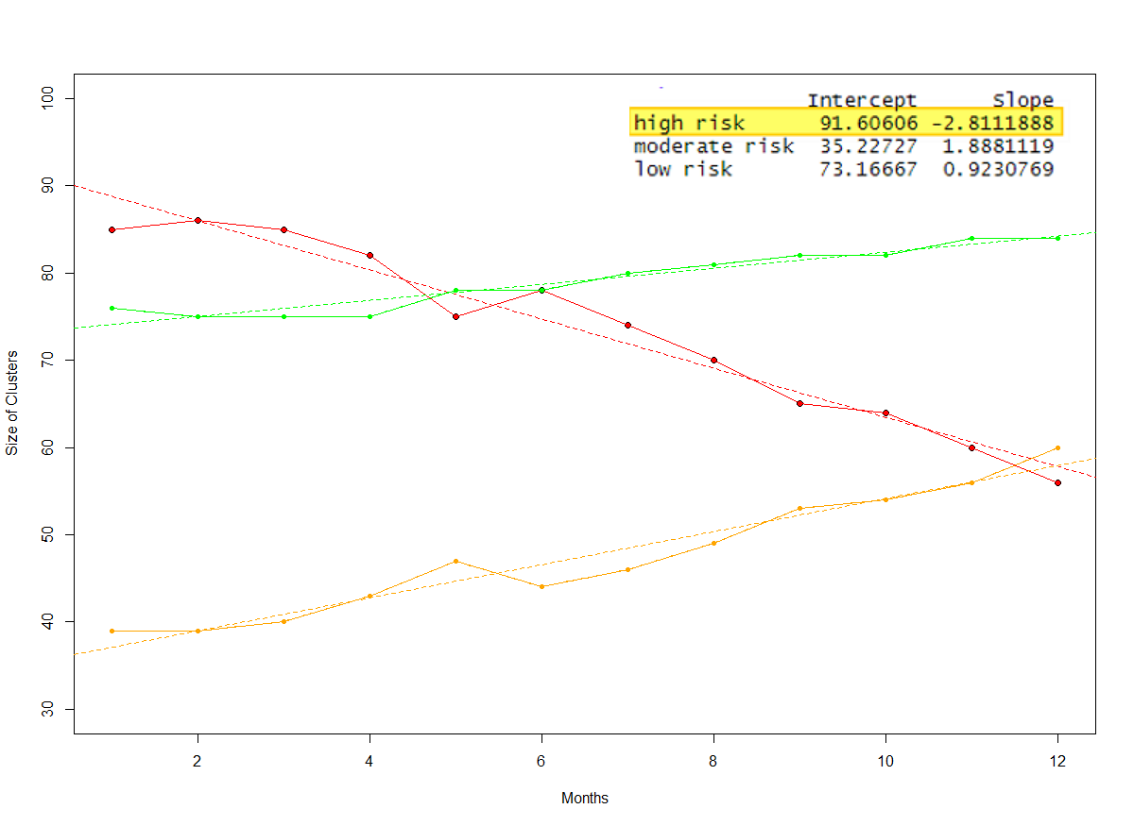
QoC design
Clustering Confidence Score (CCS) – was defined as new terms which gives the percentage of valid data points in range to the actual world. Values lies in range [0 - 10]. Score above 7 is reliable.
CCS = [[Number of correctly identified data points in all significant data attributes in the respective ranges] / [Total number of data points]] × 10
Design was based on trend analysis of cluster (k=3) sizes that are generated from the previous steps.
The focus is on the high-risk cluster size, decreasing trend of high-risk cluster indicates good QoC.
Following example data is plotted (C1: high risk cluster)
Simple linear regression (colour: red) line is added + slope details
Negative slope: Good QoC (for high risk)
 | Jan | Feb | Mar | Apr | May | Jun | Jul | Aug | Sep | Oct | Nov | Dec
C1 | 85 | 86 | 85 | 82 | 75 | 78 | 74 | 70 | 65 | 64 | 60 | 56
C2 | 39 | 39 | 40 | 43 | 47 | 44 | 46 | 49 | 53 | 54 | 56 | 60
C3 | 76 | 75 | 75 | 75 | 78 | 78 | 80 | 81 | 82 | 82 | 84 | 84
Notes:
CCS score is based on the configuration setup by a medical professional regarding the ranges observed in real-life for patients of specific chronic disease
So it plays and important role to validate the findings about the risk group formations
Score above 7 is take reliable but it can also be a preference from the medical professionals and this value can be optimized over time using this experiment over different diabetes databases
The extend of slope values can be configured too by a medical professional

Slide 19
QoC
Design is based on 3 factors:
1. CCS (ideal: > 70, observed: 96)
2. Slope of high-risk cluster (negative, -2.81)
3. Error in LM (multiple R-squared: 0.9588, adjusted R-squared: 0.9547)
Configurations can be setup to define the predicates for “good”, “average” and “bad” QoC in any system on the above mentioned factors.
Notes:
CCS: defines how many data points were correctly identified in the high-risk cluster
Slope indicates the movement of the size of cluster, we expect it to decrease so the negative slope is considered good
Error in model talks about how good the LM line fits the data points, close to 100 means all points lie on the line. So Anything above 80 should be considered good
Certainly these 3 factors should be configured by the domain experts to get proper assessment of the QoC as per their expectations.
Helpful to set up goals for care providers
Also to understand the effectiveness of certain treatment protocol
Alerts for patients moving into high-risk zone (based on prediction algo on the cluster)
Finally, the business value: customers can seen how better they are managing the patients at high risk with the application.

Slide 20
Conclusion
Real-life data on diseases like Diabetes, is not easily separable into clusters using default method of K-means or DBSCAN method. Assumption related to good separated clusters should generate risk-based groups was found to be incorrect.
Unsupervised learning (K-means clustering) helps in analysis of risk-based groups when we find the right set of data attributes.
Random Forest provides better results for attribute selection compared to Average Silhouette Width analysis.
Cluster Confidence Score plays an important role to validate the learning from the model from a medical professional.
Risk-based groups formation was observed after taking the attributes provided by Random Forest approach when prediction accuracy was acquired around 80%.
QoC for existing and new systems do have similar models based on trend of size of clusters.

Slide 21
References
M. J. Hallett, J. J. Fan, X. G. Su, R. A. Levine and M. E. Nunn, “Random forest and variable importance rankings for correlated survival data, with applications to tooth loss,” Statistical Modelling, pp. 523-547, 2014.
B. Rai, “Feature Selection and Predictive Modeling of Housing Data Using Random Forest,” International Journal of Business and Economics Engineering, vol. 11, no. 4, pp. 919-923, 2017.
C. Chapman and E. M. Feit, “R for Marketing Research and Analytics,” in R for Marketing Research and Analytics, Springer Nature, 2015, pp. 331,332,333.

Slide 22
THANKS

